Slide 1
Name: Vishnu prasath.N
3rd year B.E.CSE
NM ID:au421221104058
Email ID :vishnuprasath001234@gmail.com
3/21/2024 Annual Review

Slide 2
Image colorization
Colorizing of monochromatic images
3/21/2024 Annual Review

Slide 3


AGENDA
Introduction
Problem Statement
Project Overview
End Users
Your Solution and Its Value Proposition
The Wow in Your Solution
Modeling
Conclusion
3/21/2024 Annual Review

Slide 4

PROBLEM STATEMENT
Traditional black-and-white photographs often lack the vibrancy and realism of their color counterparts, leaving viewers with an incomplete understanding of the depicted scenes. This absence of color can diminish the emotional impact and historical context of the images, hindering the ability to fully engage with them.
Manual colorization methods are time-consuming and require expertise, making them impractical for large-scale applications.
3/21/2024 Annual Review

Slide 5
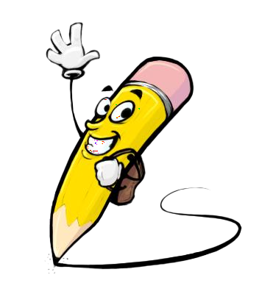
PROJECT OVERVIEW
Our project utilizes Generative Adversarial Networks (GANs) to automatically add color to grayscale images. By employing GANs, we aim to generate realistic and high-quality colorized images that closely resemble their true color counterparts.
3/21/2024 Annual Review

Slide 6

WHO ARE THE END USERS?
The end users of our image colorization solution are diverse and include historians, archivists, photographers, graphic designers, and enthusiasts of historical imagery. Historians and archivists can use the technology to breathe new life into archival photos, providing a more vivid representation of the past.
3/21/2024 Annual Review

Slide 7

YOUR SOLUTION AND ITS VALUE PROPOSITION
The model will offer a seamless and efficient method for automatically colorizing grayscale images, providing users with high-quality results in a respected time. Additionally, the solution will prioritize preserving the quality integrity of the original grayscale images while infusing them with vibrant colors.
3/21/2024 Annual Review

Slide 8

THE WOW IN YOUR SOLUTION
The wow factor of our project stems from the ability of GANs to produce minimal realistic and detailed colorizations, surpassing traditional methods in terms of quality and efficiency. Witnessing grayscale images transform into vibrant color compositions with lifelike accuracy is awe-inspiring..
3/21/2024 Annual Review

Slide 9
MODELLING
In the modeling phase, we train a GAN architecture consisting of a generator and discriminator network on a curated dataset of grayscale and color image pairs. The generator network learns to map grayscale inputs to plausible colorizations, while the discriminator network evaluates the realism of generated color images.
3/21/2024 Annual Review

Slide 10
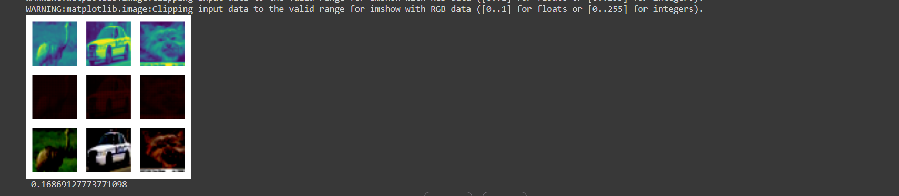
RESULTS
https://colab.research.google.com/drive/1CxbNom9C0vvmyiWB5Q3s8RSqxO1NX65f?usp=sharing
3/21/2024 Annual Review

